Slide 1
SQL Programming
DDL - Defining Constraints

Slide 2
Module 03: Defining Constraints Page A-1: Intro
The purpose of constraints is to ensure and maintain the integrity of the data in the database.
In this module we’ll examine the theory and concepts about integrity constraints and we’ll see how they can be implemented in a relational database system.

Slide 3
Module 03: Defining Constraints Page B-1: Constraints
When we drill down to the most essential characteristic of constraints, it’s this: constraints constrain the database from accepting certain values.
The database is meant to be a repository of data for our business application. We need the data in the database to be correct and valid - to possess some measure of ‘integrity’.
Constraints are a structural feature of an RDBMs that can protect columns from accepting ‘bad’ data.

Slide 4
Module 03: Defining Constraints Page B-2: Structural
Because they are built into the structure of the database, constraints provide a number of benefits to the programmer, and to the user community.
First. Constraints are defined as part of a table’s definition. Any CRUD action against a table is validated against these constraint definitions before data is allowed to enter the database.
The programmer does NOT have to write additional code to keep bad data out of the system if a constraint can check for that condition.

Slide 5
Module 03: Defining Constraints Page B-3: Structural
Second. Constraints are centrally located. All action against the table is double checked against the constraints. Even though there may be many screens and forms that permit our users to update the system, every update passes thru the same constraints.
In this regard, bad data can’t ‘slip’ into the system because a programmer failed to check for it on one of the screens.

Slide 6
Module 03: Defining Constraints Page C-1: Entity Integrity
Entity integrity assures the programmer and user that each entity is identifiable and distinguishable from every other entity.
Entity integrity is supported with two constraints:
primary key, and
NOT NULL
The primary key constraint specifies a column, or collection of columns, as the primary key for the table. When more than one column is used to form a key, the key is referred to as a composite key.
The NOT NULL constraint is used to indicate that a column may not be assigned a NULL value.

Slide 7
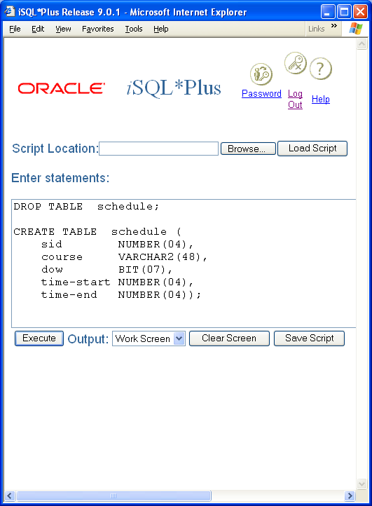
Module 03: Defining Constraints Page C-2: Domain Integrity
Domain integrity assures the programmer and user that each column contains only values that are drawn from a domain of acceptable values.
The domain specifies three characteristics for each column:
Datatype: number, character, date
Size/format: eg. 30 character name field,
date in DD-Mon-YYYY format
List of valid values for this column
The first two features are established when the column is named and defined during table creation.

Slide 8
Module 03: Defining Constraints Page C-3: Domain Integrity
The sid column is defined as a numeric column.
The column will accept only numeric values and will ‘reject’ any non-numeric values
The format specification further restricts this column to numeric values that can be represented in four, or fewer, digits.
The course column is defined as a character type of column.
Character columns generally accept any valid character in the character set, so this is not much of a restriction
This particular format specification precludes any value that contains more than 40 characters from entering the database.
The dow column is defined as a binary type column.
1. Only binary digits are acceptable in this column.

Slide 9
Module 03: Defining Constraints Page C-4: Domain Integrity
Above and beyond simply declaring a column, the programmer can also apply these constraints against a column to support domain integrity:
NOT NULL,
Unique,
Check
As mentioned earlier, the NOT NULL constraint precludes any column from accepting a NULL value. Once defined, the NOT NULL constraint guarantees the user and programmer that every column contains some value.
For the database designer, NULLs should be avoided (at all cost?). When designing a database then, all columns should ‘default’ to a NOT NULL status unless there is a significantly good reason to permit NULL values in that column.

Slide 10
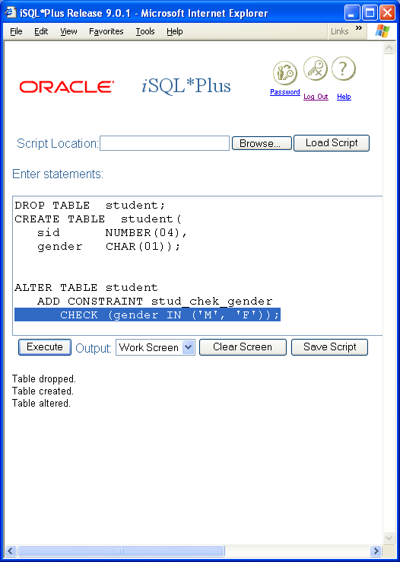
Module 03: Defining Constraints Page C-5: Domain Integrity
The unique constraint guarantees that a value may appear only once in a given column.
The check constraint allows the database designer to specify a predicate expression that can be checked prior to any CRUD action against a column. This constraint checks the value against the condition to see whether or not it is permitted in the database.
The highlighted line of code in the screen shot shows an example of a CHECK condition.
We’ll go over the mechanics behind setting up all of these constraints in just a bit, but I want to finish introducing the concepts first.

Slide 11
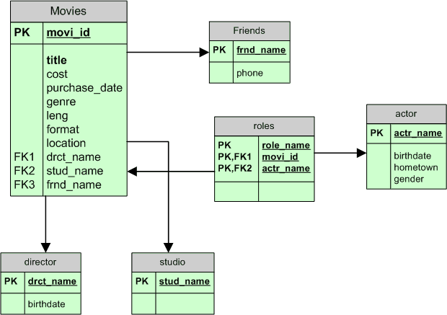
Module 03: Defining Constraints Page C-6: Referential Integrity
Referential integrity guarantees that a column (or collection of columns) contains a value that can be found in some other table.
In regard to relationships that may be defined in an ER Model, referential integrity ensures that if there is a foreign key in one relation, then each foreign key value therein must match a primary key value in the associated table.
The only other value that would be permitted in the referencing column is the NULL value. A NULL value indicates that this record does not participate in the relationship.

Slide 12
Module 03: Defining Constraints Page C-7: Referential Integrity
In the ER diagram for my movies database I have included a number of relationships. The table movies is ‘related to’ directors, studios, and friends.
These relationships might be named as follows:
directors DIRECT movies
studios PRODUCE movies
friends BORROW movies
The drct_name column in movies is a foreign key to the primary key in the director table drct_name.
In my collection, every movie must have a director, so this is a mandatory relationship, and every drct_name column in movies must have a value, and that value must be found (referenced in) the directors table.

Slide 13
Module 03: Defining Constraints Page C-8: Referential Integrity
The frnd_name column in movies is a foreign key to the primary key in the friends table frnd_name.
In my collection, at any given point in time, only some of my movies might be checked out (on loan). This relationship between movies and friends is an optional relationship, and if a movie is not presently on loan, the value in the frnd_name column should be NULL.

Slide 14
Module 03: Defining Constraints Page C-9: Integrity Constraints Summary
As I mentioned earlier, the purpose of constraints is to ensure and maintain the integrity of the data in the database.
Each of the integrity constraints that we looked at applies to the columns in a single table.
Integrity constraints can all be defined at the time that the table is created. To my way of thinking, this ‘muddies up’ the table creation and makes it a little more difficult to read and understand.
My preference is to define the constraints after the table has been created, and to apply those constraints with an ALTER TABLE DDL statement.

Slide 15
Module 03: Defining Constraints Page D-1: Integrity Constraints
In this section we’ll see how to apply these integrity constraints:
NOT NULL
primary key
unique
check
foreign key

Slide 16
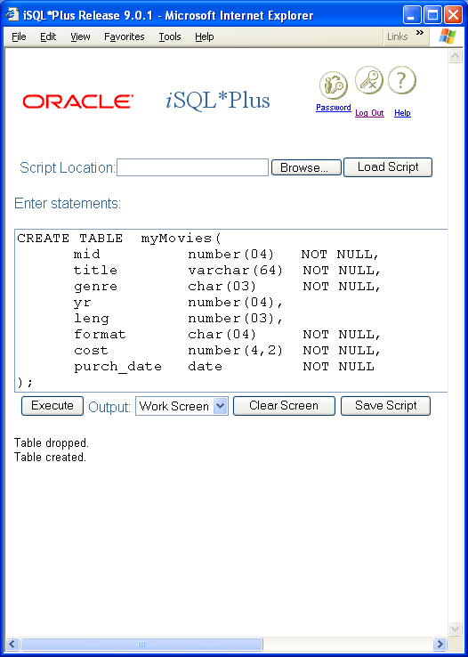
Module 03: Defining Constraints Page D-2: NOT NULL
Of all the constraints, the NOT NULL constraint is the only constraint that I define during table creation.
This constraint is specified immediately after the data type specification.
You should plan on setting each column as NOT NULL, unless you have a darn good reason not to.
Here I’ve defined every column as NOT NULL with the exception of the yr the movie was produced, and the length of the movies.
My usage of the movies database is to record an entry as soon after the purchase as I can. All of the information about a movie is immediately available on the jacket case, with the exception maybe of yr and leng. If I were to define these two columns as NOT NULL, then I wouldn’t be able to post an entry in my db without that info.
Hmmm. I don’t want that. So I’ll permit those columns to contain NULL values.

Slide 17
Module 03: Defining Constraints Page D-3: ALTER TABLE
My preference is to use the ALTER TABLE statement to apply integrity constraints.
Here’s how I read/plan for that statement.
What do I want to do?

Slide 18
Module 03: Defining Constraints Page D-4: ALTER TABLE
My preference is to use the ALTER TABLE statement to apply integrity constraints.
Here’s how I read/plan for that statement.
What do I want to do?
Change a table:
ALTER TABLE

Slide 19
Module 03: Defining Constraints Page D-5: ALTER TABLE
My preference is to use the ALTER TABLE statement to apply integrity constraints.
Here’s how I read/plan for that statement.
What do I want to do?
Change a table:
ALTER TABLE
Which table?

Slide 20
Module 03: Defining Constraints Page D-6: ALTER TABLE
My preference is to use the ALTER TABLE statement to apply integrity constraints.
Here’s how I read/plan for that statement.
What do I want to do?
Change a table:
ALTER TABLE
Which table?
myMovies
ALTER TABLE myMovies
Okay, that’s part 1.

Slide 21
Module 03: Defining Constraints Page D-7: ALTER TABLE
After Part 1, I’ve got:
ALTER TABLE myMovies
How do I want to change the table?

Slide 22
Module 03: Defining Constraints Page D-8: ALTER TABLE
After Part 1, I’ve got:
ALTER TABLE myMovies
How do I want to change the table?
I want to add a constraint
ALTER TABLE myMovies
ADD CONSTRAINT xxxxx
And what name do I want for the constraint?

Slide 23
Module 03: Defining Constraints Page D-9: ALTER TABLE
After Part 1, I’ve got:
ALTER TABLE myMovies
How do I want to change the table?
I want to add a constraint
ALTER TABLE myMovies
ADD CONSTRAINT xxxxx
And what name do I want for the constraint?
How about something that identifies the table, and the kind of constraint this is.
movi_pk
ALTER TABLE myMovies
ADD CONSTRAINT movi_pk

Slide 24
Module 03: Defining Constraints Page D-10: ALTER TABLE
After Part 2, I’ve got:
ALTER TABLE myMovies
ADD CONSTRAINT movi_pk
What kind of constraint is this?

Slide 25
Module 03: Defining Constraints Page D-11: ALTER TABLE
After Part 2, I’ve got:
ALTER TABLE myMovies
ADD CONSTRAINT movi_pk
What kind of constraint is this?
A primary key constraint.
ALTER TABLE myMovies
ADD CONSTRAINT movi_pk
PRIMARY KEY()
Which column(s) comprise the primary key?

Slide 26
Module 03: Defining Constraints Page D-12: ALTER TABLE
After Part 2, I’ve got:
ALTER TABLE myMovies
ADD CONSTRAINT movi_pk
What kind of constraint is this?
A primary key constraint.
ALTER TABLE myMovies
ADD CONSTRAINT movi_pk
PRIMARY KEY()
Which column(s) comprise the primary key? The mid column.
ALTER TABLE myMovies
ADD CONSTRAINT movi_pk
PRIMARY KEY(mid)

Slide 27
Module 03: Defining Constraints Page D-13: ALTER TABLE - Summary
The syntax for the ALTER TABLE command reads like the following:
What are you doing? ALTERING
What are you altering, a TABLE
Which table
How are you altering it (eg.adding a constraint)
Name it
Any further specifications? (primary key)
Which parts of the table are affected (column list)

Slide 28
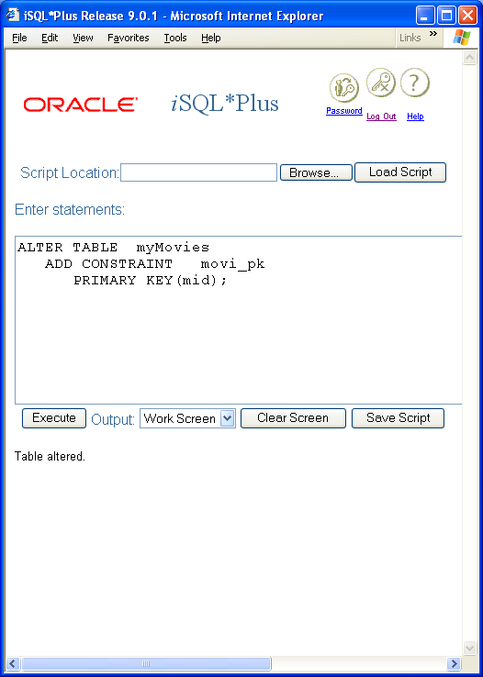
Module 03: Defining Constraints Page D-14: Primary Key Constraint
As we just saw, primary key constraints can be defined as follows:
ALTER TABLE myMovies
ADD CONSTRAINT movi_pk
PRIMARY KEY (mid);
It helps to provide a meaningful name for objects, and in this case you want to assign a meaningful name to the primary constraint.
One standard that I’ve employed is to use the 4 character abbreviation for the table, + the abbreviation ‘pk’ to signify primary key (eg. movi_pk).

Slide 29
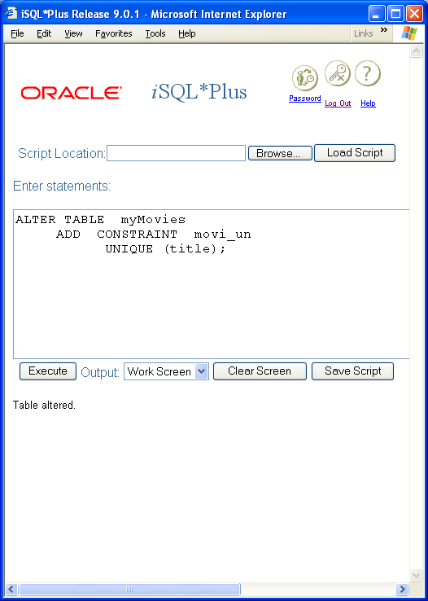
Module 03: Defining Constraints Page D-15: Unique Constraint
Unique constraints can be similarly defined as follows:
ALTER TABLE myMovies
ADD CONSTRAINT movi_un
UNIQUE (title);
The constraint name is a combination of the table abbreviation + the code for constraint type (movi_un).

Slide 30
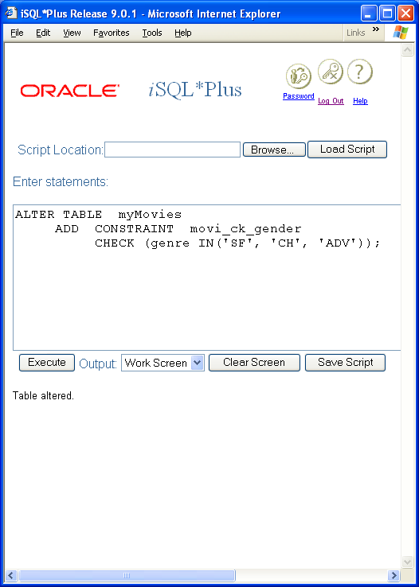
Module 03: Defining Constraints Page D-16: Check Constraint
The check constraint is also defined using this general pattern.
ALTER TABLE myMovies
ADD CONSTRAINT movi_ck_genre
CHECK (genre IN(‘SF’, ‘CH’, ‘ADV’));
In this case, the constraint name is a combination of the table abbreviation + the code for constraint type, and, since many columns might have their own check constraint, something to identify the column.
movi + ck + genre

Slide 31
Module 03: Defining Constraints Page D-17: Check Constraint
MySQL does not yet implement CHECK constraints.

Slide 32
Module 03: Defining Constraints Page D-18: Foreign Key Constraint
The foreign key constraint is used to ensure referential integrity.
ALTER TABLE myMovies
ADD CONSTRAINT movi_fk_frnd
FOREIGN KEY(frnd_name)
REFERENCES friends(frnd_name);

Slide 33
Module 03: Defining Constraints Page D-19: Constraint Summary
This pretty much covers the options that are available to the database designer and programmer in establishing single table constraints.
Each of these constraints can be applied using a form of the ALTER TABLE command.

Slide 34
Module 03: Defining Constraints Page E-1: Assertions
The magic word when we discuss constraints is table. And the scope of any constraint is limited to a single table.
The CHECK clause cannot reference anything outside of the table in which it is defined.
But what happens when we need to validate data against some other table?
One option is to can use a foreign key reference. But this is essentially limited to validating an entry in some other table.
The other option is to use an assertion.

Slide 35
Module 03: Defining Constraints Page E-2: Assertions
An assertion is analogous to a table constraint in that the main clause of an assertion is also a CHECK clause.
Unlike constraints (which are anchored to tables), assertions are ‘standalone’ objects, and are created in the database with a CREATE ASSERTION statement.
The format of this statement is:
CREATE ASSERTION name
CHECK (predicate expression)
The Oracle implementation does not yet support assertions.

Slide 36
Module 03: Defining Constraints Page F-1: Constraints
Constraints are removed from the database using the DROP phrase in the ALTER statement.
ALTER TABLE table_name
DROP CONSTRAINT constraint_name;
That’s the syntax, but I have to tell ya’ that this doesn’t quite jibe with my intuitions. It seems to me that if we’re going to use CREATE and DROP to add and remove structures from the database we ought to be consistent.
But when we add constraints we find ourselves using a new phrase/verb: ADD instead of CREATE. Then when it comes time to remove the constraint, instead of using something like REMOVE, we’re back to DROPing the object!
I would appreciate some consistency, …

Slide 37
Module 03: Defining Constraints Page F-2: Constraints
but then again, perhaps Emerson said it best:
“A foolish consistency is the hobgoblin of little minds, …”

Slide 38
Module 03: Defining Constraints Page G-1: Dependencies
So far we’ve considered constraints as tools to ensure that only good, ‘clean’ data gets into the database.
But constraints also serve a role in ensuring that only good data ‘stays’ in the database.
Consider the special case of foreign key constraints.
When we establish a foreign key reference (ie. referential integrity) we tell the database to insist that any updates (or insertions) to the foreign key columns be validated against the corresponding primary table.
In one of the examples that we considered earlier, we wanted to ensure that student records only used valid major codes, and we established a foreign key constraint on the major code column of the student table.

Slide 39
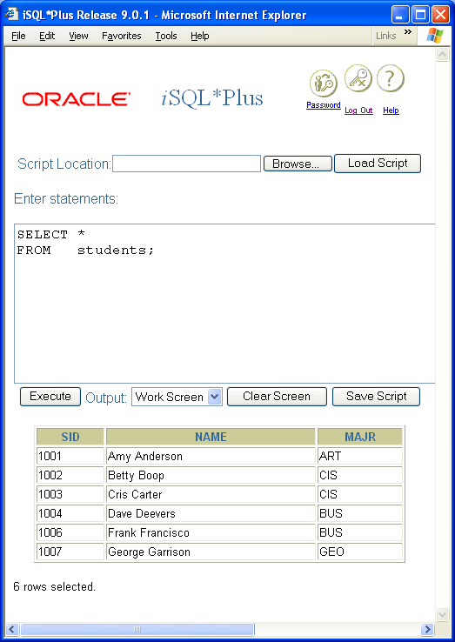
Module 03: Defining Constraints Page G-2: Dependencies
This guaranteed us that whenever the major code column in the student table changed that it would be validated against the primary table.
For example, we can only add student records with a GEOLOGY major, if the GEOLOGY major exists in the majors table.
Perfecto! Exactly what we want.
But what happens if we were to DELETE the geology major from the majors table?
That’s an attack on the integrity of the data from ‘the other side’.
In this regard it’s a little trickier, but we’ve got the tools to manage this kind of threat. And this is the feature we’re going to discuss now that preserves ‘good’ data in the database.

Slide 40
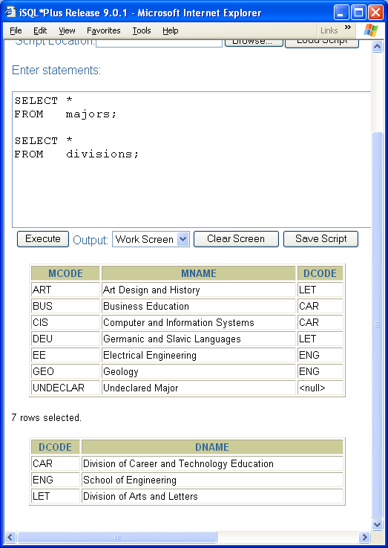
Module 03: Defining Constraints Page G-3: Dependencies
Let’s consider the scenario where we delete the GEOLOGY major from the majors table.
What would be the sensible thing to do to/for our remaining geology majors?
We could change them all to UNDECLARED majors.
2. We could flag their records as not having a major code.
3. We could delete all of their records.

Slide 41
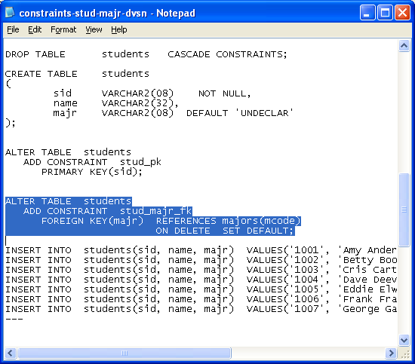
Module 03: Defining Constraints Page G-4: ON DELETE, SET DEFAULT
The first option, that changes all remaining students to UNDELCARED majors, could be accommodated with the ON DELETE, SET DEFAULT phrase.
This feature is defined in the standard, but is not implemented, yet, in Oracle.

Slide 42
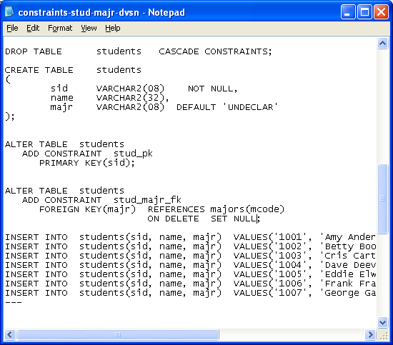
Module 03: Defining Constraints Page G-5: ON DELETE, SET NULL
The next option, that resets the major code of all geology majors to NULL, is set with the ON DELETE, SET NULL phrase.
View the next set of slides.

Slide 43
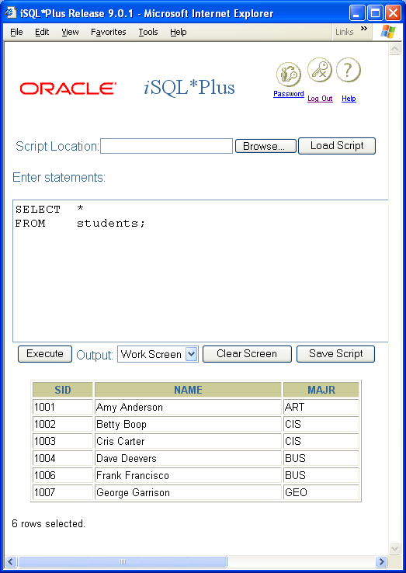
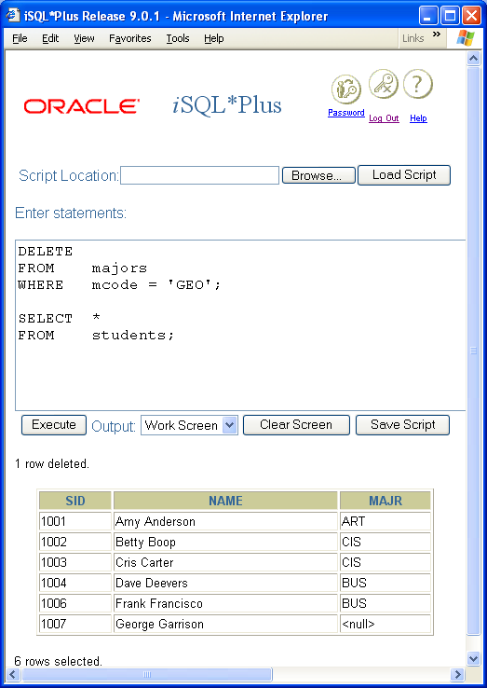
Module 03: Defining Constraints Page G-6: ON DELETE, SET NULL

Slide 44
Module 03: Defining Constraints Page G-7: ON DELETE, SET NULL
Notice that the students table is automatically updated to reflect the deletion that occurred in the majors table.
Each row/column that referenced the GEOLOGY major has been set to NULL.

Slide 45
Module 03: Defining Constraints Page G-8: ON DELETE, CASCADE
The CASCADE option has the effect of cascading the delete throughout all effected tables.
Every row that has a foreign key reference is deleted when its primary record is deleted.

Slide 46
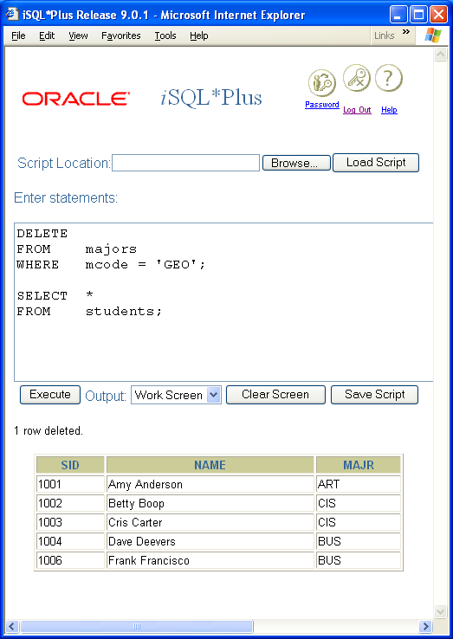
Module 03: Defining Constraints Page G-9: ON DELETE, CASCADE

Slide 47
Module 03: Defining Constraints Page G-10: ON DELETE, CASCADE
The students table is reduced from 6 rows to 5 as a result of the DELETE command that was applied to the majors table.

Slide 48
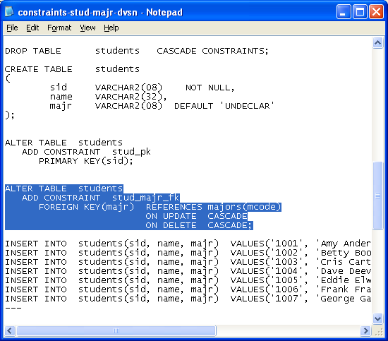
Module 03: Defining Constraints Page G-11: ON UPDATE
The SQL:1999 standard also allows the programmer to specify these same three constraint actions ON UPDATE.
In this example (which is not yet implemented in Oracle) the ON UPDATE CASCADE phrase tells the database to cascade the effect of the update throughout all effected tables.
In this example, if the value of the primary key in the majors table changed, that change would be reflected in the student table.
For example, if we were to change the majors(mcode) value from GEO to GEOL then all student(mcode) values that presently have the value GEO, would be updated to the new value: GEOL.

Slide 49
Module 03: Defining Constraints Page G-12: Transactions
There are two other options for our referential constraints:
NO ACTION, and
RESTRICT
But we’ll discuss their impact later in the course, after we’ve discussed the concept of database transactions.

Slide 50
Module 03: Defining Constraints Page T-1: Terminology
Constraints, integrity constraints
Domain constraints
Entity integrity
Referential integrity
Primary key
Composite key
Domain constraint and check constraint
Primary key constraint and unique constraint
Foreign key constraint
ON UPDATE
ON DELETE
SET NULL
SET DEFAULT
CASCADE
Assertions

Slide 51
Module 03: Defining Constraints Page Z-1: End Notes
Please drop me an email if you noticed any errors in this module. I’d also appreciate reading your comments, criticisms, and or suggestions as to how this module could be improved.
Were there any gaps in the information that was presented (ie. ‘leaps of faith’)?
Was any section unclear?
Did I happen to do a good job? ☺
Thanks,
bil

Slide 52
That’s All

